Slide 1

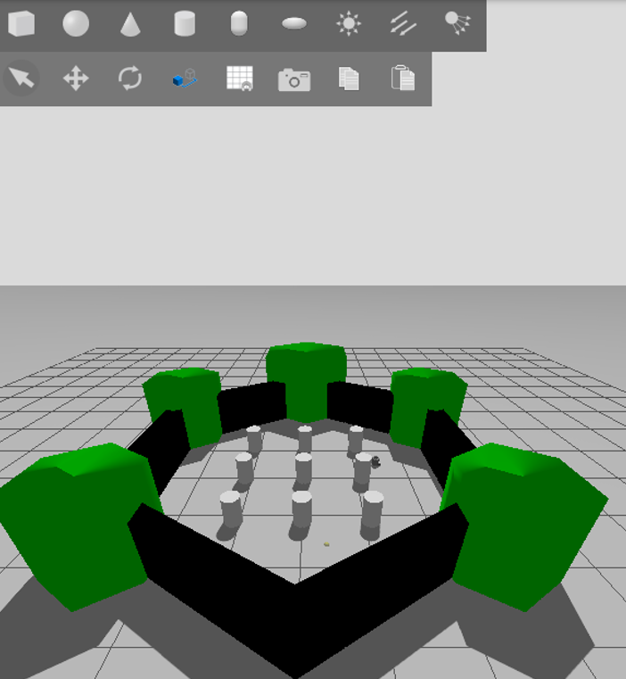
Obstacle Avoidance in
Autonomous Navigation
with ROS 2
Group OBS-3
MPPI vs. DWA Local Planners | ROS 2 Jazzy + Gazebo
Md Mushfiqul Islam - 1438422 | Rezoyana Islam Bonna - 1502329
Supervisor: Prof. Dr. Peter Nauth

Slide 2
Project Overview
What We Did
• Simulated TurtleBot3 Burger in ROS 2 Jazzy • Compared MPPI vs. DWA local planners • 4 scenarios: static, narrow, dynamic, mixed • 8 experiment runs with automated metrics
Static
Narrow
Dynamic
Mixed
5 fixed
box obstacles
0.6 m gap
corridors
2 moving
cylinders
Static +
Dynamic

Slide 3
LIVE DEMONSTRATION
Simulation in Action
ROS 2 Jazzy + Gazebo Harmonic + Nav2 + TurtleBot3 Burger

Slide 4
Results — Key Numbers
38%
0%
MPPI navigated successfully: ✓ Static scenario (2 of 3 runs) ✓ Narrow passage scenario ✗ Dynamic & Mixed (timeout)
MPPI | 3 / 8 runs
DWA | 0 / 8 runs
Scenario | Path (m) | Min Dist (m) | Near-Coll. | Success
Static | 2.53 / 3.49 | 0.302 | 0 | ✓
Narrow | 2.90 | 0.281 | 4 | ✓
Dynamic | 3.45 | 0.259 | 24 | ✗
Mixed | 0.02 | 0.120 | 182 | ✗
Robot radius = 0.22 m | Goal = 4.0 m straight line

Slide 5
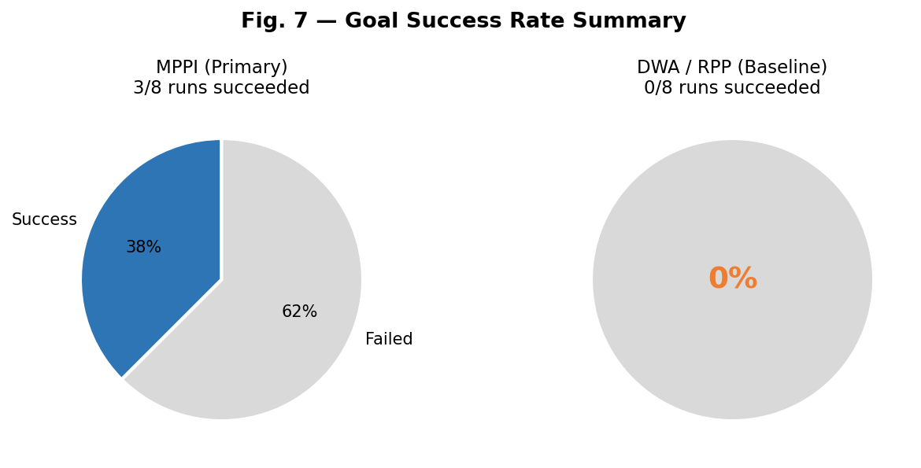
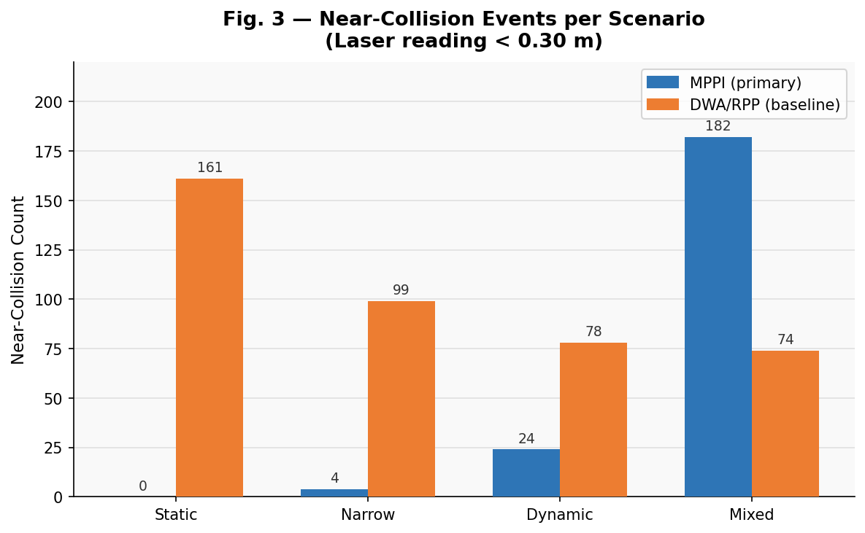
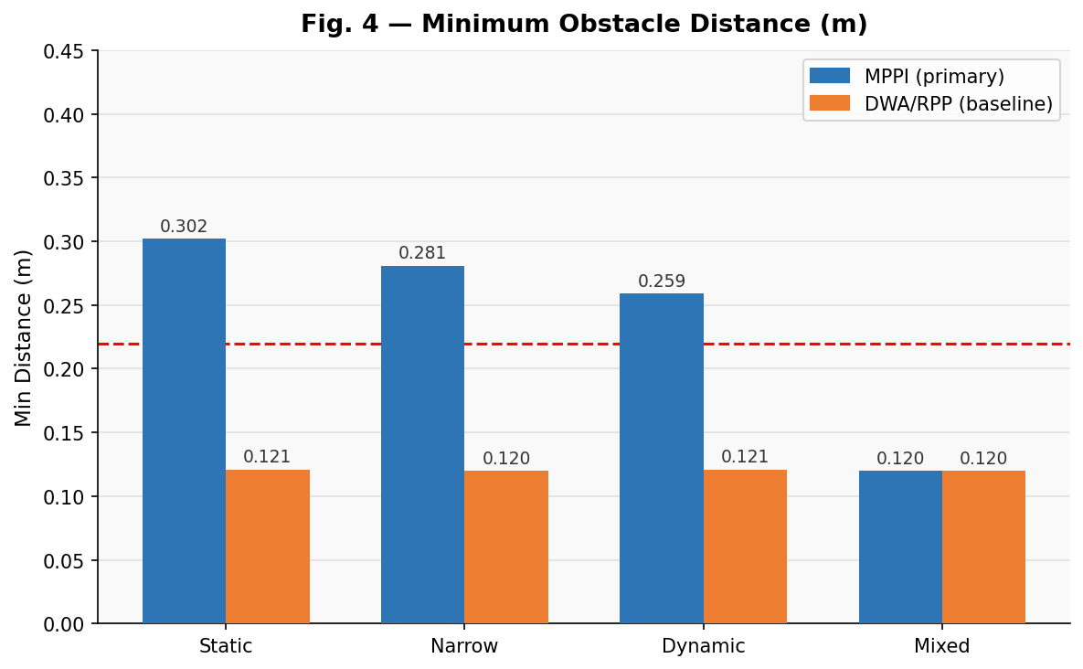
Results — Performance Graphs
What the Data Shows
MPPI scores 5/6 on path efficiency and replanning — actively adapts every cycle. DWA scores 0 on 5 of 7 criteria — never moved in any run. Min obstacle distance stays above robot radius (0.22 m) in all MPPI successes.

Slide 6
Findings & Limitations
01
TEB unavailable on ROS 2 Jazzy
3 breaking API changes in libg2o and nav2_core prevent compilation. Documented fully — real ecosystem gap affecting published research.
02
DWA needs better localisation
We used a static TF instead of AMCL. DWA/RPP requires precise pose estimation — this explains the 0% success rate, not a planner weakness.
03
MPPI excels in static environments
38% overall success. Fails in fast-moving dynamic scenarios. Future: AMCL + hybrid TEB/MPPI + real TurtleBot3 hardware deployment.

Slide 7
Thank You

